Slide 1
Executive Matching Ranker Baseline Model
Daniel Godden
July 2023

Slide 2
What are we trying to solve?
Identify which senior executives to recommend for deal opportunities.
Explore ways to improve this solution.
We want to a way to automate the improvement of this solution.

Slide 3
Data Processing & Feature Engineering | 4-6
Model Training - LightGBM | 7-9
Results and Evaluation | 10-12
Automating Solution | 13-16
Next Steps | 17-20

Slide 4
Data Processing & Feature Engineering

Slide 5
Data Processing & Feature Engineering
Data Loading
Load three CSV datasets:
exec_roles.csv – Executive metadata (ID, attribute type, value)
match.csv – Historical matches between executives and assignments, with binary outcomes
opp.csv – Opportunity metadata (industry, sectors, sub-sectors, scale, country)
Standardise ID fields (assignment_id, exec_entity_id) to Int64 for consistent merges and handling of missing values.
Transform exec_roles.csv from long to wide format so each executive has a single row with attributes as separate columns.
Notes:
Load three CSV datasets
exec_roles.csv – Contains detailed metadata about each executive.
Each row represents a single attribute for an executive.
Columns typically include executive ID, type of attribute (e.g., sector, skill, experience), and its value.
Example: 12345, sector, finance.
match.csv – Contains historical records of matches between executives and assignments.
Includes a binary outcome (e.g., 1 for successful match, 0 for unsuccessful).
This is effectively our label for supervised learning.
opp.csv – Holds metadata about opportunities (projects or roles).
Includes categorical details like industry, sector, sub-sector, scale (size of opportunity), and country.
Standardise ID fields
Convert assignment_id and exec_entity_id to Int64.
Ensures IDs are handled consistently across datasets.
Prevents merge issues caused by mixed types (e.g., strings vs integers).
Handles missing IDs gracefully because Int64 in Pandas supports NaN.
Transform exec_roles.csv from long to wide format
The current “long” format has one row per attribute per executive.
Pivot the table so each executive appears only once.
Each attribute type becomes a separate column.
This structure is more suitable for machine learning models that expect one row per entity with features in columns.

Slide 6
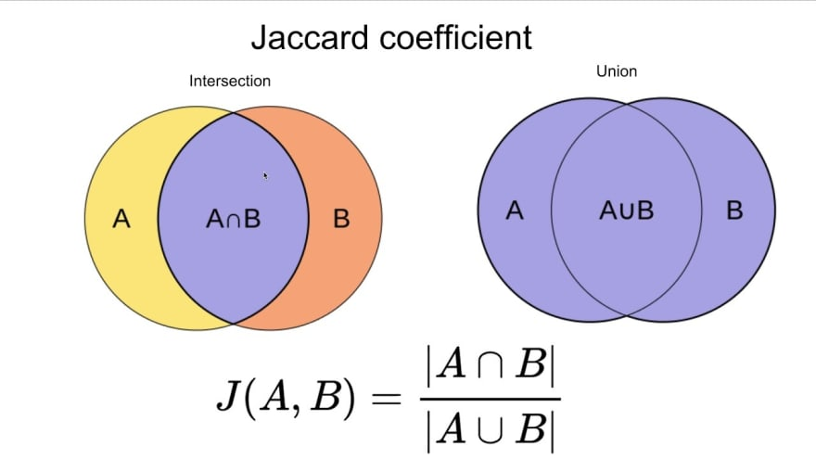
Data Processing & Feature Engineering
Feature Engineering
Feature Engineering
Binary match features:
- Sector match (json_value_sectors == sectors)
- Country match (hq_address == country)
- Scale match (scale == string_value_scale)
Similarity scores:
- Jaccard similarity for sectors, sub_sectors, industry
Features computed for each exec–opportunity pair to capture alignment in domain, geography, and company size
Notes:
Binary match features
Sector match: exact match between exec sector and opportunity sector.
Country match: HQ location matches opportunity country.
Scale match: company size matches opportunity size.
Similarity scores
Jaccard similarity: compares sets of values (e.g., sectors, sub-sectors, industry) to measure how much they overlap.
Formula: intersection ÷ union of the two sets.
Range: 0 = no common elements, 1 = perfect match.
In this context: useful when exec and opportunity have multiple sectors or industries — allows us to score partial matches instead of treating them as a full mismatch.
Goal
Capture both exact matches and degrees of similarity to better quantify fit in domain, geography, and company size.

Slide 7
Model Training - LightGBM

Slide 8
Model Training - LightGBM
Data Prep for Training
Keep only rows with no missing values in key features and outcome
Keep only opportunities (assignment_id) with at least one positive match (outcome = 1)
Split data by assignment_id (~10% test set) to prevent leakage and preserve ranking context
Prepare LightGBM Ranker inputs:
- X_train – Feature matrix
- y_train – Binary match labels
- group_train – Number of executives evaluated per opportunity
Notes:
Remove incomplete rows
Only keep rows with no missing values in key features or the target label — ensures the model sees complete, usable data.
Keep only viable opportunities
Filter to assignment_ids with at least one positive match (outcome = 1) — the model needs examples of success to learn ranking patterns.
Split by opportunity
Assign ~10% of assignment_ids to the test set.
Prevents data leakage and keeps ranking evaluation realistic by grouping execs under the same opportunity in the same split.
LightGBM Ranker inputs
X_train: feature matrix for model training.
y_train: binary match labels (1 = good match, 0 = poor match).
group_train: number of executives evaluated per opportunity — essential for ranking models to know group boundaries.

Slide 9
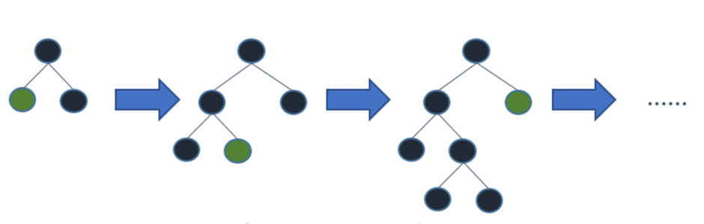
Model Training - LightGBM
LightGBM Ranker
Use LGBMRanker for Learning to Rank (LTR) tasks, based on the LambdaMART algorithm
- Optimizes ranking loss functions (e.g., NDCG)
- Learns which items (execs) should rank higher for each (assignment_id)
Key parameters:
- n_estimators=100 – Number of boosting rounds
- force_col_wise=True – Forces column-wise tree building for efficiency
Notes:
Use LGBMRanker (Learning to Rank)
Based on LambdaMART algorithm.
Optimizes ranking loss functions like NDCG (Normalized Discounted Cumulative Gain).
A loss function measures how far off the model’s predictions are from the ideal ranking.
In ranking tasks, the loss focuses on ordering items correctly rather than predicting exact values.
Learns which executives should be ranked higher for each assignment_id.
Why it matters: Purpose-built for ranking tasks — ideal for recommending the top matches rather than just predicting yes/no.
Key Parameters
n_estimators = 100: Number of boosting rounds; more rounds can improve accuracy but increase training time.
force_col_wise = True: Improves efficiency in building trees, especially with wide datasets.
Why it matters: Ensures the model is tuned for both accuracy and performance.

Slide 10
Results and Evaluation

Slide 11
Results and Evaluation
Model Evaluation
Precision@5 measures how often the correct exec appears in the top 5 predictions for each opportunity
- Sort execs by predicted score within each assignment_id
- Select the top 5 execs
- Count as a hit if at least one has outcome = 1
Final score = mean hit rate across all opportunities
High Precision@5 → model frequently includes the correct match in its top 5 suggestions

Slide 12
Results and Evaluation
Predicting New Results
rank_execs_for_new_opp() simulates ranking execs for a new opportunity
Pairs the given opportunity with every executive
Builds the same feature columns used in training
Predicts a score for each exec–opportunity pair
Returns the top 10 ranked execs by predicted score
Mimics the real-world recommendation process for a live opportunity
Notes:
rank_execs_for_new_opp()
Simulates ranking executives for a brand-new opportunity.
Why it matters: Allows us to test and apply the model in a realistic scenario.
Pairs the opportunity with every executive
Creates all possible exec–opportunity combinations.
Why it matters: Ensures no candidate is missed in evaluation.
Builds the same feature columns used in training
Reproduces identical input structure for the model.
Why it matters: Consistency between training and prediction prevents errors and bias.
Predicts a score for each pair
Model outputs a relevance score.
Why it matters: Higher scores indicate stronger predicted matches.
Returns the top 10 ranked execs
Sorted by predicted score.
Why it matters: Focuses attention on the most promising candidates.
Mimics the real-world recommendation process
Matches how the system would run in production.
Why it matters: Validates the end-to-end pipeline for live use.

Slide 13
Automating Solution

Slide 14
Automating Solution
Automation Benefits
Ensures model is always up-to-date with latest data
No manual intervention required for retraining or logging
Metrics (precision@5) automatically tracked over time for monitoring
Model artifacts versioned via GitHub Actions for reproducibility
Enables seamless transition from training → deployment

Slide 15
Automating Solution
GitHub Actions
Workflow (train_ranker.yml) runs every day at 6 AM UTC
Steps include:
- Checkout code from repository
- Install dependencies from requirements.txt
- Run train_ranker.py to retrain model and log metrics
- Upload updated model (lgbm_ranker.pkl) and precision_log.csv as artifacts
Also supports manual trigger from the Actions tab

Slide 16
Automating Solution
Further Automation Options
Apache Airflow
- Orchestrate ETL → training → deployment pipelines
- Schedule retraining and manage task dependencies
- Store DAGs in Git for version control
AWS Athena
- Query large datasets directly from S3 without ETL into PostgreSQL
- Ideal for preprocessing before training
AWS Lambda + EventBridge
- Trigger lightweight training or scoring jobs on schedule or on data updates
AWS Step Functions
- Manage multi-step workflows (data extract → train → evaluate → deploy)

Slide 17
Next Steps

Slide 18
Next Steps
Opportunities to Improve Model - Model
Better Models
- CatBoostRanker – handles categorical features natively
- XGBoostRanker – strong baseline for sparse/tabular data
- Neural ranking models – e.g., DSSM, BERT-based
- Transformer encoders – richer semantic similarity from text

Slide 19
Next Steps
Opportunities to Improve Model - Data
Enhanced Features
- Embeddings: dense vectors + cosine similarity for sector, industry, country
- Temporal: time since last match, posting recency
- Exec activity: selection count, success ratio by sector/industry
- Interaction features: sector + country + scale co-occurrence patterns
Data Enrichment
- Exec bios, past job history, skills tags
- Company descriptions, financial metrics
- Standardise sector/industry naming

Slide 20
Next Steps
Opportunities to Improve Model – Productionise and Scale
ETL Pipeline – Extract data from PostgreSQL/S3, compute features (Airflow/Lambda), store in S3/staging table
Model Training – Batch jobs on EC2/SageMaker, versioning & tracking via Mlflow
Model API – FastAPI app on ECS/Lambda exposing /predict for top 10 execs
Predictions Table – Log predictions in PostgreSQL for validation & feedback
Monitoring & Retraining – CloudWatch metrics (volume, latency, Precision@5 drift), auto-trigger retrains
Retraining Workflow – Weekly/monthly retraining, promote only if performance improves
Notes:
ETL Pipeline
Extract data from PostgreSQL/S3, compute features with Airflow or Lambda, store in S3/staging table.
Why it matters: Automates and standardises data preparation for consistent inputs.
Model Training
Run batch jobs on EC2 or SageMaker, track versions and metrics with MLflow.
Why it matters: Ensures reproducibility and allows performance comparison over time.
Model API
Deploy FastAPI app on ECS/Lambda, expose /predict for top 10 executives.
Why it matters: Makes predictions available to applications in real time.
Predictions Table
Log predictions in PostgreSQL for validation and feedback loops.
Why it matters: Supports model monitoring, auditability, and retraining with real outcomes.
Monitoring & Retraining
Track metrics like volume, latency, and Precision@5 drift in CloudWatch; auto-trigger retrains if needed.
Why it matters: Detects performance drops early and keeps recommendations accurate.
Retraining Workflow
Retrain weekly/monthly; only promote if performance improves.
Why it matters: Prevents degradation while avoiding unnecessary updates.

